Slide 1

Department of Information Technology
Project Phase - II
Review - III
“CAREBOT : PATIENT HISTORY AUTOMATION”
TEAM MEMBERS
ALEX RAYER A [21UIT009]
GUNAAL T [21UIT044]
VASANTH R [21UIT175]
Under the Guidance of
MISS. A.SOWBARNIKA
ASSISTANT PROFESSOR
INFORMATION TECHNOLOGY

Slide 2
Agenda
Abstract Motivation Problem Statement Proposed System Modules Algorithms Implementation Work Conclusion Publication

Slide 3
Abstract
The practice of gathering a patient's medical history has been fundamental to healthcare for centuries, serving as the basis for accurate diagnoses and effective treatment plans. Traditional face-to-face consultations often result in incomplete medical histories due to time constraints and communication barriers. Carebot history taking systems have emerged as a transformative solution, leveraging technology to enhance data collection and patient engagement. These systems allow patients to complete questionnaires or surveys before their appointments, enabling them to provide comprehensive medical histories at their own pace.

Slide 4
Introduction
In the evolving landscape of healthcare, the need for efficient and accurate patient data collection has become increasingly critical. Traditional methods of gathering patient information often involve time-consuming manual processes and are prone to errors and inconsistencies. To address these challenges, automated patient data collection systems have emerged as a transformative solution. The systems leverage advanced technologies such as data analytics, and artificial intelligence to streamline and enhance the process of collecting, storing, and managing patient information.

Slide 5
Motivation
Inadequate Patient Histories:
Traditional face-to-face consultations often result in incomplete patient histories due to time constraints and communication barriers. Inadequate histories can lead to misdiagnosis, inappropriate treatment plans, and increased risk of medication errors and adverse drug reactions.
Shortage of Healthcare Professionals :
India, like many other countries, faces a severe shortage of doctors and healthcare providers. The high patient-to-doctor ratio makes it challenging to dedicate sufficient time to each patient, affecting the quality of history-taking and overall care.
Efficiency in Healthcare Delivery:
The healthcare system is under constant pressure to improve efficiency. Carebot history-taking systems can streamline the process, allowing healthcare providers to focus on addressing specific concerns during consultations, thus optimizing the use of limited time and resources.

Slide 6
Problem Statement
Limitations of Traditional Methods: Traditional face-to-face consultations often result in incomplete medical histories due to time constraints and communication barriers.
Impact on Patient Care: Incomplete histories hinder healthcare providers' ability to make accurate diagnoses and develop effective treatment plans, negatively affecting the quality of patient care.
Need for Innovative Solutions: There is a growing need for innovative solutions that facilitate comprehensive data collection prior to patient appointments to enhance consultation efficiency and patient engagement.

Slide 7
Proposed System
Web-Based Portals: Online platforms where patients can log in to fill out their medical history, symptoms, and other relevant information before their appointment.
Mobile Applications: Smartphone apps that allow patients to enter their medical history and health concerns conveniently, with reminders for completion before consultations.
AI-Powered Chatbots: Interactive chatbots that guide patients through a series of questions to collect their medical history and symptoms, providing a user-friendly interface for data entry.

Slide 8
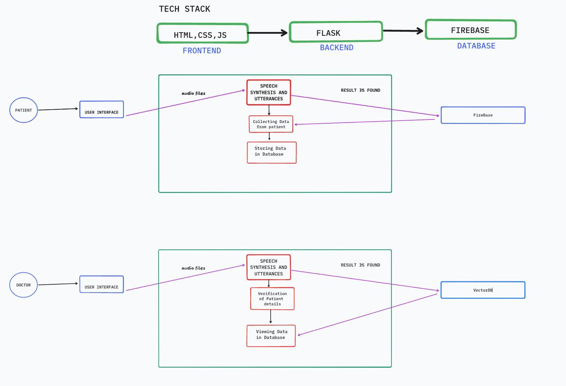
Proposed Architecture

Slide 9
Modules Identified
User Registration and Authentication Module:
Allows patients to log in securely, and manage their profiles.
Ensures data privacy and security through authentication protocols.
Symptom Assessment Module:
Guides patients through a series of questions to assess their current symptoms and concerns.
Utilizes branching logic to tailor questions based on previous answers.
Data Validation and Error Checking Module:
Ensures that the information entered by patients is complete and accurate.
Provides prompts for missing information or inconsistencies.
Voice Module:
Added interaction voice module for understanding conversation .
It is also helpful for blind people interaction.

Slide 10
Algorithms and Techniques used:
Named Entity Recognition (NER): Identifying and classifying key entities in the text, such as patient names, medical conditions, medications, and dates.
Text Classification: Categorizing text data into predefined classes, such as identifying the type of medical issue or urgency level.
Part-of-Speech Tagging: Identifying the grammatical parts of speech in a sentence to understand the structure and meaning.
Transformers: Models like BERT (Bidirectional Encoder Representations from Transformers) and GPT (Generative Pre-trained Transformer) are used for understanding context in text data and generating human-like responses.
DOM: Document Object model is used to connect from javascript file to access the text to speech or speech to text content.
BOM: Browser Object model is used to connect the sever by generating the URL for this project.

Slide 11
Implementation work(100%)
Develop System Architecture: Design the overall architecture of the automated system, including data flow, storage, and integration points with existing systems.
Ensure Compliance: Implement necessary security measures to protect patient data and ensure compliance with relevant regulations.
Data Migration: Plan and execute the migration of existing patient data into the new system, ensuring data integrity and accuracy.
API Integration: Utilize application programming interfaces (APIs) to connect the automated system with existing EHRs, telehealth platforms, and other relevant systems.

Slide 12
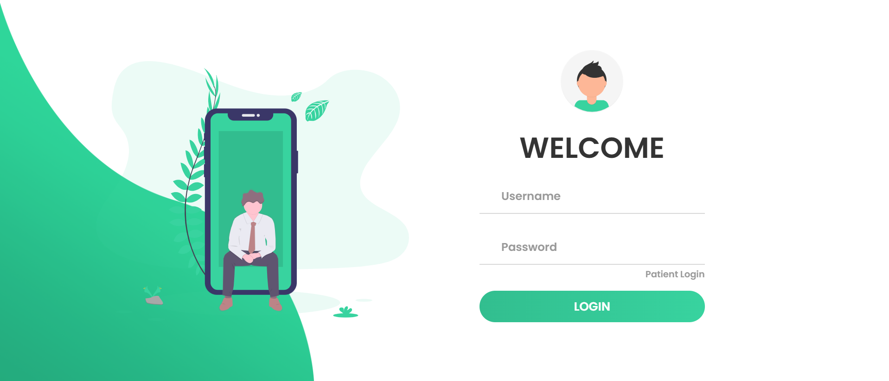
Results-Implementation Screenshots(Doctor portal)

Slide 13
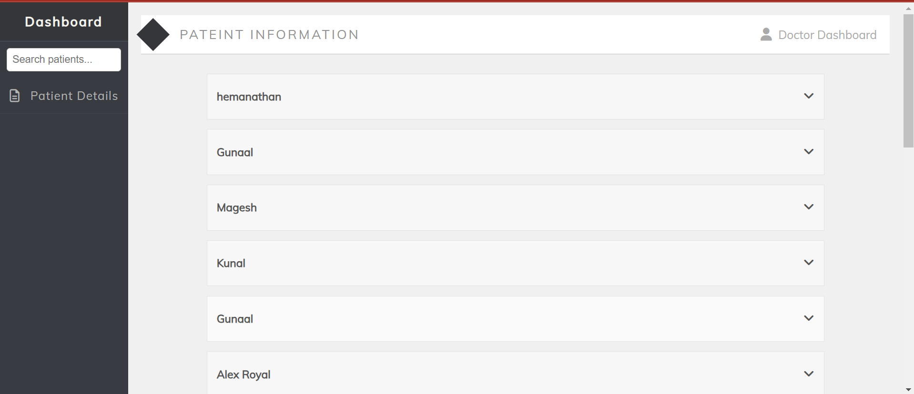
Results-Implementation Screenshots

Slide 14
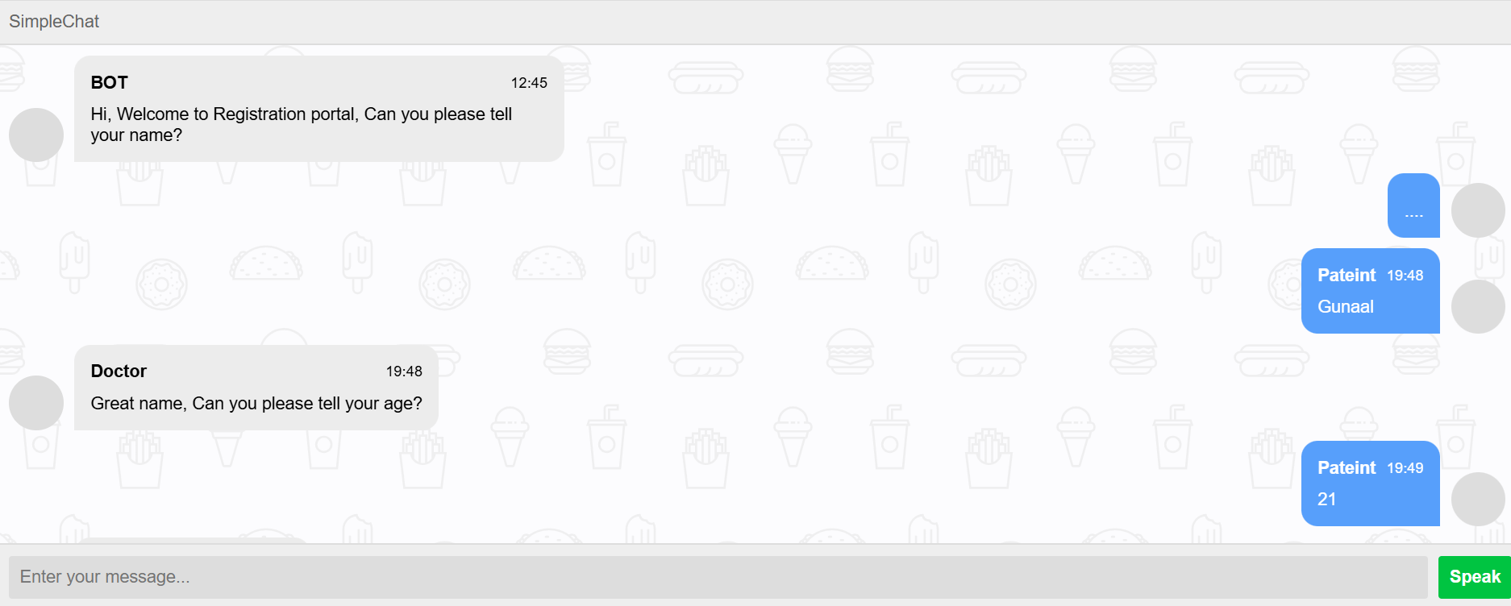
Results-Implementation Screenshots(Patient portal)

Slide 15
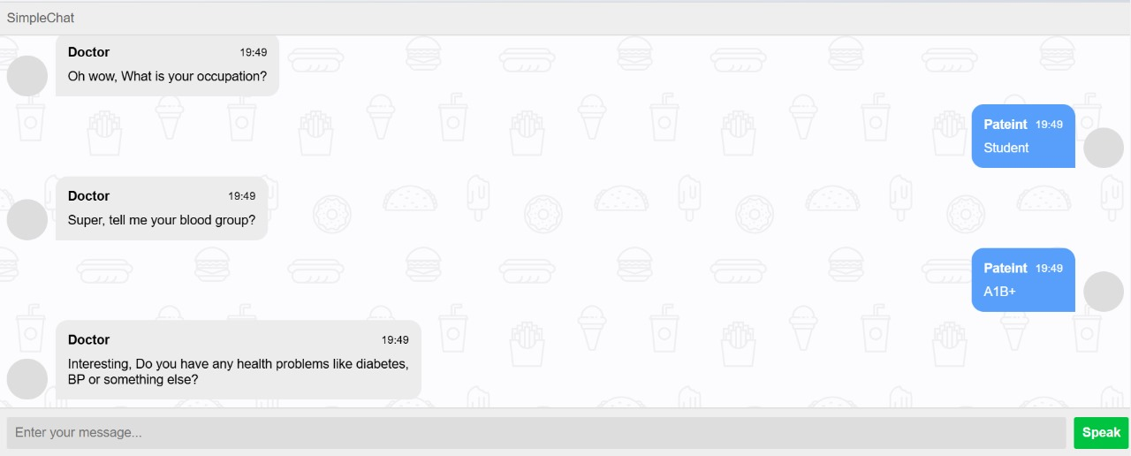
Results-Implementation Screenshots

Slide 16
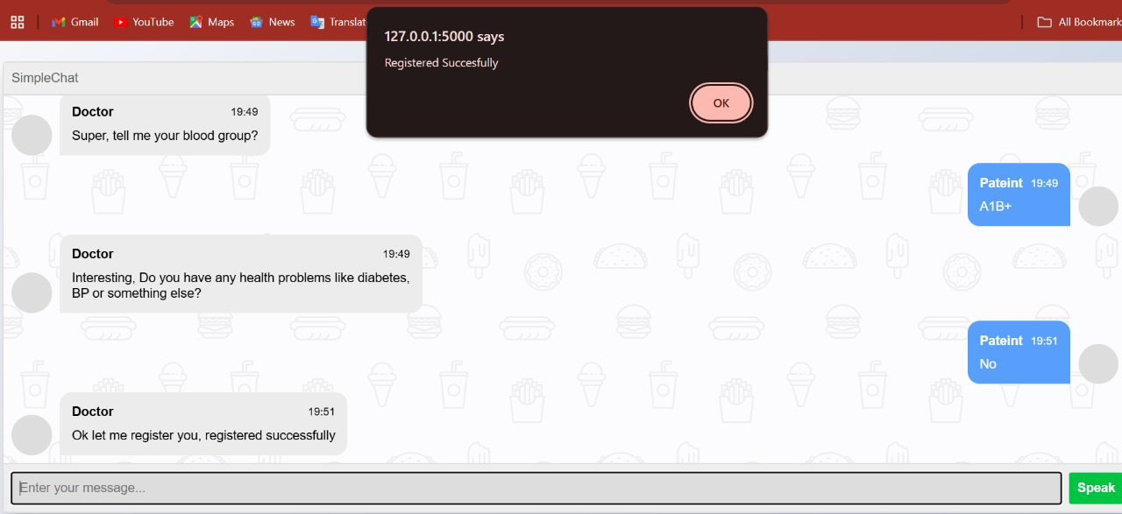
Results-Implementation Screenshots

Slide 17
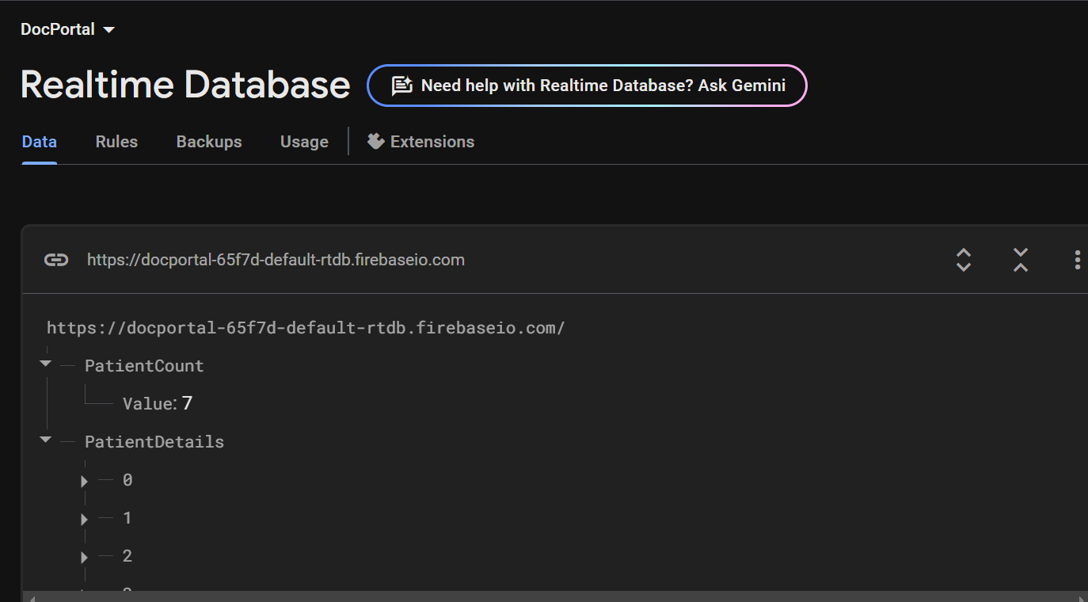
Results-Implementation Screenshots

Slide 18
Software and Hardware Requirements
SOFTWARE REQUIREMENTS:
Operating System: Windows.
Programming Language: Python.
Database: Firebase.
IDE: Visual Studio Code.
HARDWARE REQUIREMENTS:
Processor: Any Processor above 500 MHZ.
RAM: 8GB.
Hard Disk: 500GB.
Input device: Standard Keyboard and Mouse.
Output Device: VGA and Monitor.

Slide 19
References
[1] Gulnur Zhakhina1,2, Karina Tapinova.Pre-consultation history taking systems and their impact on modern practices: Advantages and limitations. Journal Of Clinical Medicine Of Kazakhstan. IEEE Journal. 2023.
[2] Wenxing Hong 1 , Ziang Xiong1 , Nannan Zheng1 , and Yang Weng. A Medical-History-Based Potential Disease Prediction Algorithm. IEEE Journal Access.2019.
[3] P. William; Yogeesh N; Vishal M Tidake. Framework for Implementation of Personality Inventory Model on Natural Language Processing with Personality Traits Analysis.IEEE ACCESS conference.2022.
[4] María D. Illescas-Manzano , Noé Vicente López . Implementation of Chatbot in Online Commerce, and Open Innovation. IEEE Journal.2023.
[5] Alessandro Mazzei;Luca Ansemia. Anticipating User Interactions in customer care dialogue system.IEEE ACCESS conference.2021.
[6] Asoke Nath , Rupamita Sarkar , Swastik Mitra, Rohitaswa Pradhan.Designing and Implementing Conversational Intelligent Chat-bot Using Natural Language Processing.IEEE Journal. 2022.
[7] Ganesh Reddy Gunnam. Assessing Performance of Cloud-Based Heterogeneous Chatbot Systems and A Case Study. IEEE Journal Access. 2024.

Slide 20
[8] Taisei Takahashi,Yan Zhihao,Kazumasa Omote. Emergency Medical Access Control System Based on Public Blockchain. Springer. 2024.
[9] Marco Polignano. HealthAssistantBot: A Personal Health Assistant for the Italian Language. IEEE Journal Access.2020.
[10] Mohd Asif Shah. An AI-Based Medical Chatbot Model for Infectious Disease Prediction. IEEE Journal Access.2022.
[11] Hendry Naufal Marbella, Izzat Aulia Akbart, Bambang Setiawan.Design and development of a web-based patient management information system. Elsevier. 2023.
[12] Giada Confortala , Mika Takata , Naoaki Yokoi, and Masashi Egi.Enhancing Predictive Models to Lower Rehospitalization Risk: Utilizing Historical Medical Records for AI-Driven Interventions . IEEE Journal Access.2024.
[13] Hendry Naufal Marbella, Izzat Aulia Akbar†, Bambang Setiawan.Secure System Medical Record with Blockchain System: Recchain Framework. IEEE Journal Access. 2024.
[14] Joseph Finkelstein , Aileen Gabriel, Susanna Schmer, Andrew Dunn.Identifying Facilitators and Barriers to Implementation of AI‑Assisted Clinical Decision Support in an Electronic Health Record System. Springer.2024.

Slide 21
[15] Giacomo Scaioli, Manuela Martella, Giuseppina Lo Moro1. Knowledge, Attitudes, and Practices about Electronic Personal Health Records: A Cross-Sectional Study in a Region of Northern Italy. Springer. 2024.
[16] Lanyun Zhang , Jiani Zhan, Verena Kwok Wai Wan, And Yanbin Wang. Designing and Evaluating Online Health Consultation Interfaces: A Perspective of Physician-Patient Power Asymmetry .IEEE Journal.2024.
[17] Maisie Wang,C. Lau,Frederick A. Matsen,Yongmin Kim.Personal health information management system and its application in referral management. IEEE Journal Access.2004.
[18] Joseph Finkelstein , Aileen Gabriel, Susanna Schmer, Andrew Dunn. Meaningful use of patient-centric health records for healthcare transformation.IEEE Journal. 2012.
[19] Manuel Gil1 , Reemel Sherif2 , Manon Pluye2 , Benjamin C. M. Fung 1 , (Senior Member, IEEE), Roland Grad2 , and Pierre Pluye2.Towards a Knowledge-Based Recommender System for Linking Electronic Patient Records With Continuing Medical Education Information at the Point of Care . IEEE Journal Access.2019.
[20] Peter Adebowale Olujimi and Abejide Ade-Ibijola.NLP Techniques for automating responses to customer quries:A systematic Review. Springer.2023.

Slide 22
Publication status
Title: SURVEY ON CAREBOT : A PATIENT HISTORY AUTOMATION
Authors Name: A Sowbarnika , T Gunaal , R Vasanth , A Alex Rayer .
Conference Name: International Conference on ‘Computing, STEM and Applied Sciences’
(ICCSIS -2025).
Organized by: B. K. Birla College, Kalyan, Maharashtra, India.
Conference Date: 21th - 22th Mar 2025.
Conference Status: Abstract accepted and Paper Submitted.

Slide 23
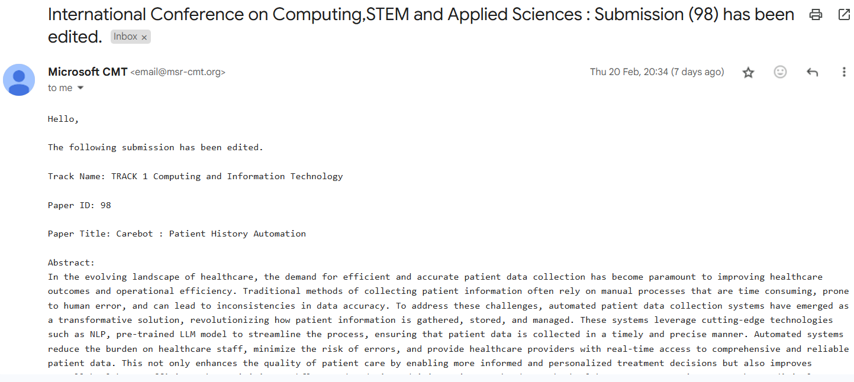

Slide 24
Publication status
Title: CAREBOT : A PATIENT HISTORY AUTOMATION
Authors Name: A Sowbarnika , T Gunaal , R Vasanth , A Alex Rayer .
Journal Name: Journal of Knowledge Management and Artificial Intelligence.
Conference Status: Abstract accepted and Paper Submitted.

Slide 25
